Slide 1
Heart Disease Diagnostic Analysis
-By VISHAL SINGH TOMAR

Slide 2
CONTEXT
Problem Statement
Data Used
Analysis & Insights
Conclusion

Slide 3
Problem Statement
Health is real wealth in the pandemic time we all realized the brute effects of covid-19 on all ,irrespective of any status.
We are required to analyze this health and medical data for better future preparation.

Slide 4
Data Used
age: Age of the patient
sex: Sex of the patient (0 = Female, 1 = Male)
cp: Chest pain type (0-3)
trestbps: Resting blood pressure (in mm Hg)
chol: Serum cholesterol in mg/dl
fbs: Fasting blood sugar > 120 mg/dl (1 = true; 0 = false)
restecg: Resting electrocardiographic results (0-2)
thalach: Maximum heart rate achieved
exang: Exercise-induced angina (1 = yes; 0 = no)
oldpeak: ST depression induced by exercise relative to rest
slope: The slope of the peak exercise ST segment (0-2)
ca: Number of major vessels (0-3) colored by fluoroscopy
thal: Thalassemia (0 = normal; 1 = fixed defect; 2 = reversible defect)
target: Heart disease (0 = no, 1 = yes)
Dataset Contains :
1025 rows of data.
14 attributes.
723 rows of data were found to be duplicate.
After removal of the duplicates, left with 302 rows of data.

Slide 5
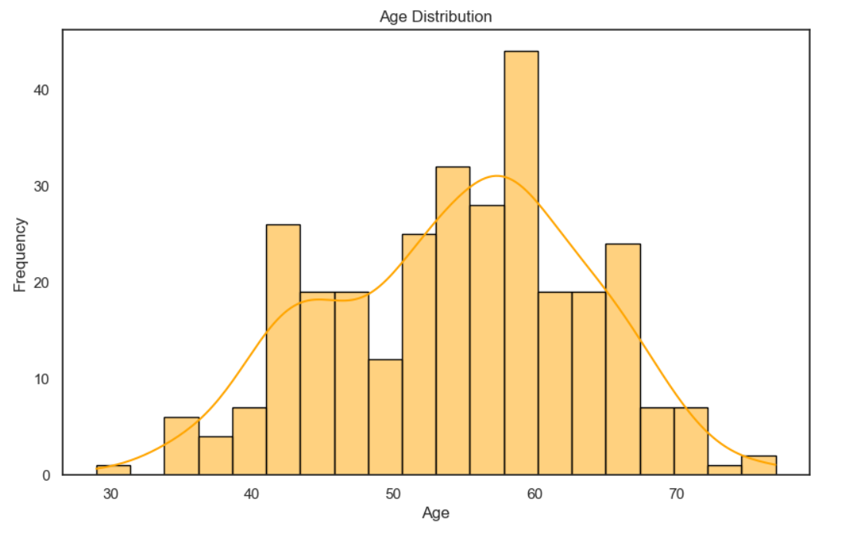
Analysis & Insights
Age Distribution:
The age distribution shows that the majority of patients are between 40 and 70 years old.

Slide 6
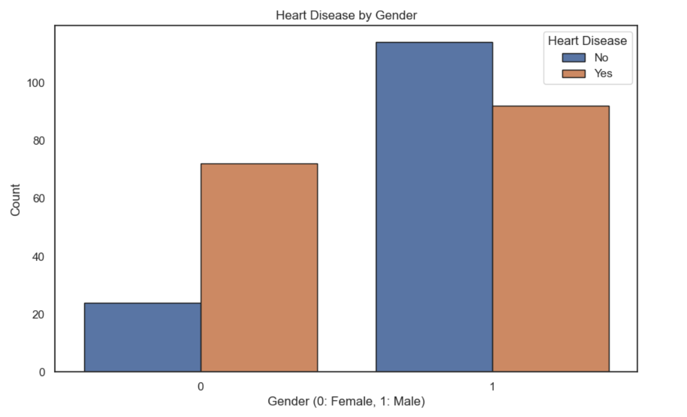
Analysis & Insights
Heart Disease by Gender:
Males (sex=1) are more frequently diagnosed with heart disease compared to females (sex=0).

Slide 7
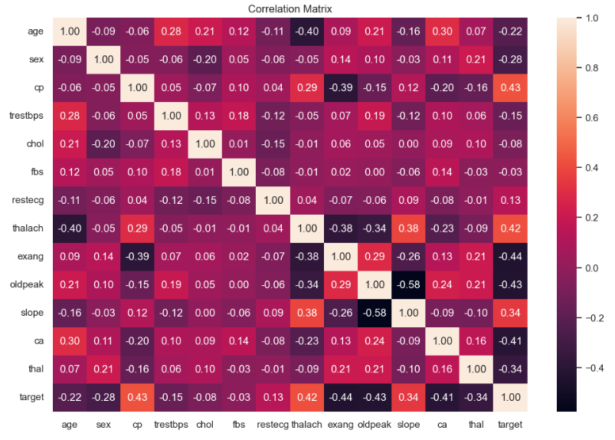
Analysis & Insights
Correlation Matrix:
A positive correlation between oldpeak and target, suggesting higher ST depression values are associated with heart disease.

Slide 8
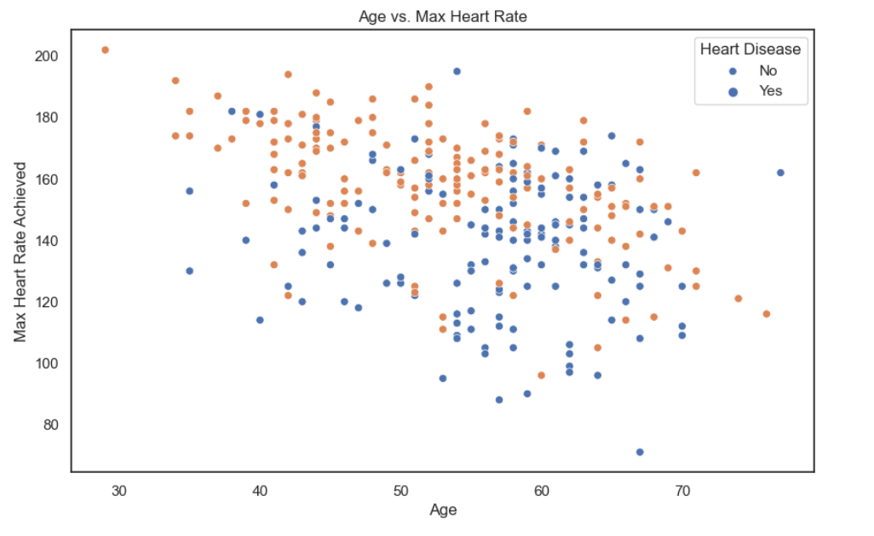
Analysis & Insights
Age v/s Max Heart Rate:
Younger patients generally achieve higher maximum heart rates.

Slide 9
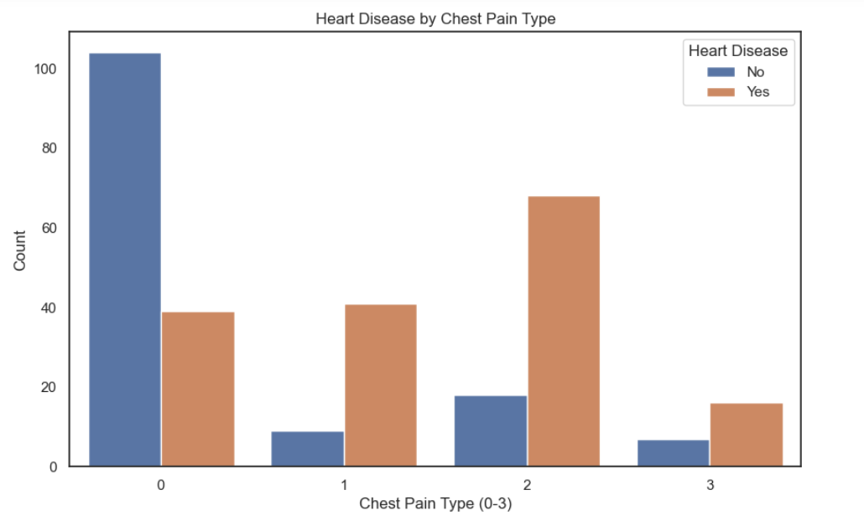
Analysis & Insights
Heart Disease by Chest Pain Type:
Maximum people having heart disease are those people having chest pain of level-2.

Slide 10
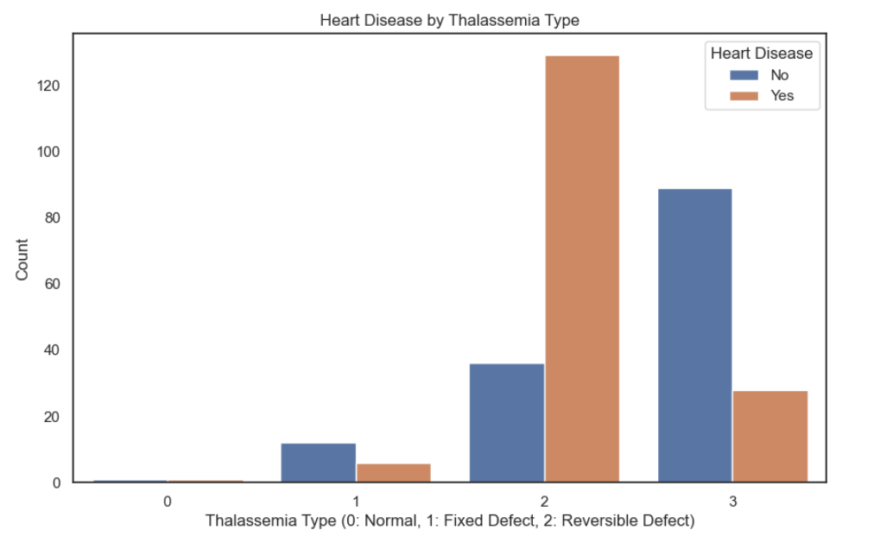
Analysis & Insights
Heart Disease by Thalassemia Type:
People Having Thalassemia type 2 are having frequent Heart Diseases.

Slide 11
CONCLUSION
The age distribution shows that the majority of patients are between 40 and 70 years old.
Males (sex=1) are more frequently diagnosed with heart disease compared to females (sex=0).
There are several notable correlations, such as:
A negative correlation between thalach (maximum heart rate achieved) and age.
A positive correlation between exang (exercise-induced angina) and target (heart disease).
A positive correlation between oldpeak and target, suggesting higher ST depression values are associated with heart disease.
The scatter plot shows that younger patients generally achieve higher maximum heart rates. There is a visible difference between patients with and without heart disease.
Maximum people having heart disease are those people having chest pain of level-2.
Persons having ST Depression that is old peak 0 are having frequent Heart Diseases.
People Having Thalassemia type 2 are having frequent Heart Diseases.

Slide 12
THANK YOU

